Slide 1

NFI phase 2 systematic sampling along space filling curve
Gael Sola (FAO), February 2023
FAO NFCI project on Strengthening Indonesian Forest and land management
for climate actions

Slide 2
Content
General principles
Phase 1 sampling size and grid spacing
Phase 2 demo of plot selection process
Remaining questions

Slide 3
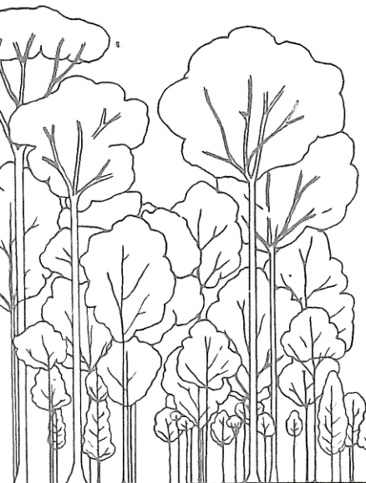
General Principles

Slide 4
Overall process
2 phases systematic sampling design:
Phase 1: systematic grid over the entire area and stratification of grid using auxiliary info.
Phase 2: Estimation of valid sample points from phase 1 and sub-sampling among valid plot locations for field visit.

Slide 5
Overall process
Phase 1:
Have enough grid points for area estimation with acceptable uncertainty.
Have enough points after removing non-forest and inaccessible plots to match final sampling size with a margin of security.
Additional constraint: Enough grid points to detect forest changes with acceptable uncertainty
Additional constraint: Enough grid points to apply SFC to get spatial homogenous representation (~ 100 x more points than needed)
Generally, the finest possible resolution that can be processed in an efficient manner should be chosen. In the case of our study, 1,064,467 potential sample locations were generated.
(Lister and Scott, 2009, https://doi.org/10.1007/s10661-008-0184-y)

Slide 6
Overall process
Phase 2:
Only demonstration of the method during current project as visual interpretation of location validity required before final selection of phase 2 field work plot location
Demonstration based on distance to road and river and presence of forest from land cover map 2021.
The demonstration can inform if the phase 1 initial grid is over or under sampling for field plot selection
Method: (to be adjusted based on phase 1 interpretation)
Space filling curve in upland strata and non-forest trees
random sampling in mangrove (applicability of SFC to mangrove to be tested) and primary swamp forest

Slide 7
Phase 1 sampling size and grid spacing

Slide 8
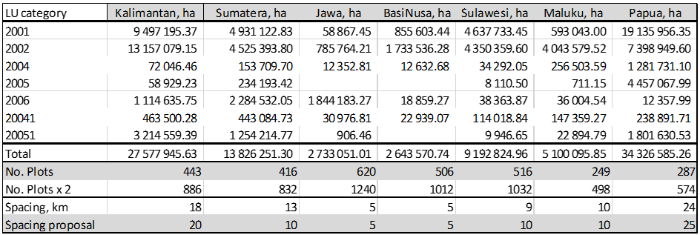
Phase 1 sampling size and grid spacing
First estimate of phase 1 grid spacing: 2 x number of field plots over the strata forest areas

Slide 9
Phase 1 sampling size and grid spacing
Proposed updates to sampling design:
Revision of initial spacing based on availability of plots after removing inaccessible and non forest (land cover 2021 approximation)
Revision of initial spacing based on uncertainty level for change detection (sample-based area estimation)

Slide 10
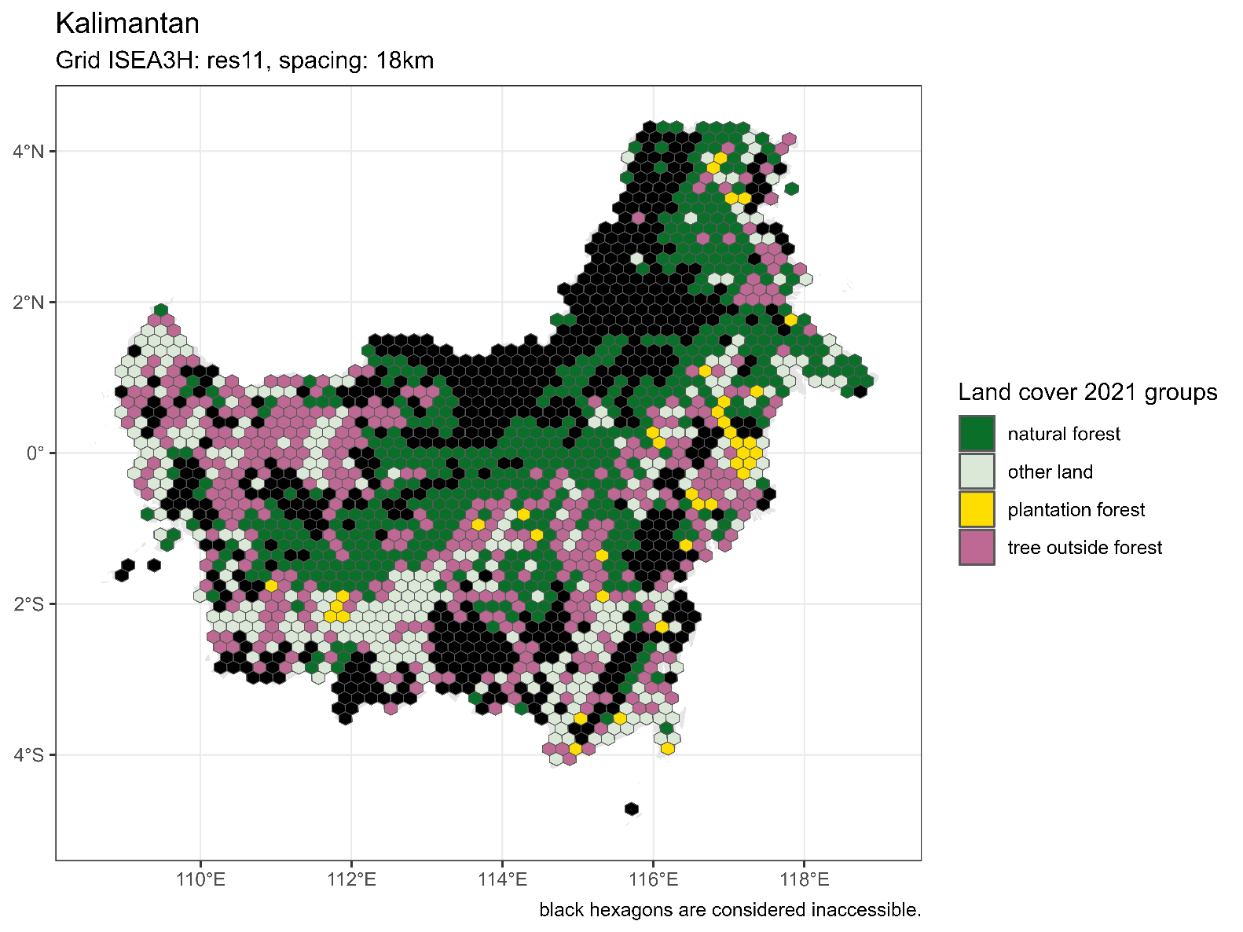
Phase 1 sampling size and grid spacing
Example: Kalimantan
Phase 2: 413 plots
lc2021_group | total | no_access | access | valid
natural forest | 1866 | 406 | 515 | 503
other land | 1866 | 70 | 313 | 0
plantation forest | 1866 | 5 | 39 | 39
tree outside forest | 1866 | 115 | 403 | 0
TOTAL | 7464 | 596 | 1270 | 542

Slide 11
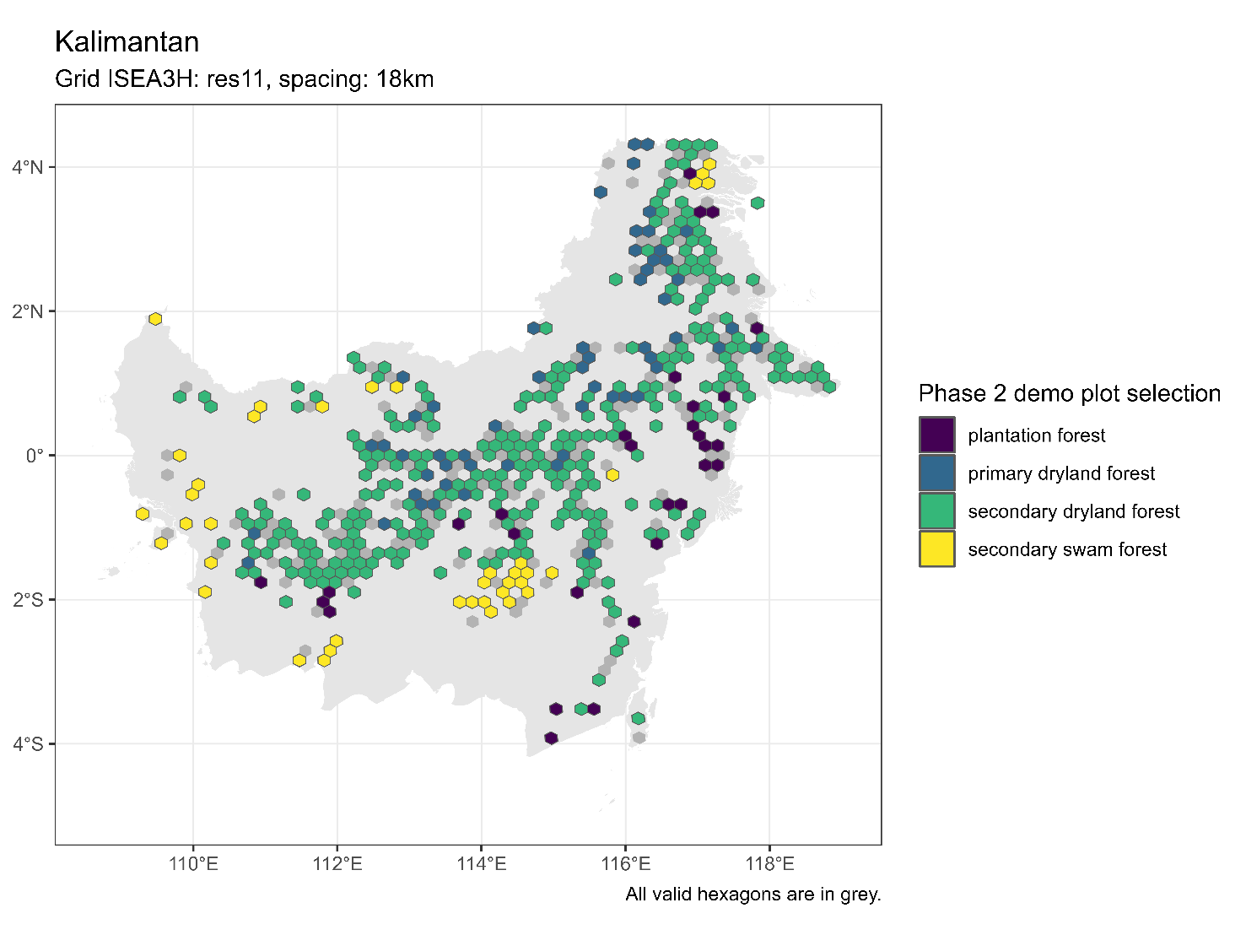
Phase 1 sampling size and grid spacing
Example: Kalimantan
Phase 2: 413 plots
lc2021_group | total | no_access | access | valid
natural forest | 1866 | 406 | 515 | 503
other land | 1866 | 70 | 313 | 0
plantation forest | 1866 | 5 | 39 | 39
tree outside forest | 1866 | 115 | 403 | 0
TOTAL | 7464 | 596 | 1270 | 542

Slide 12
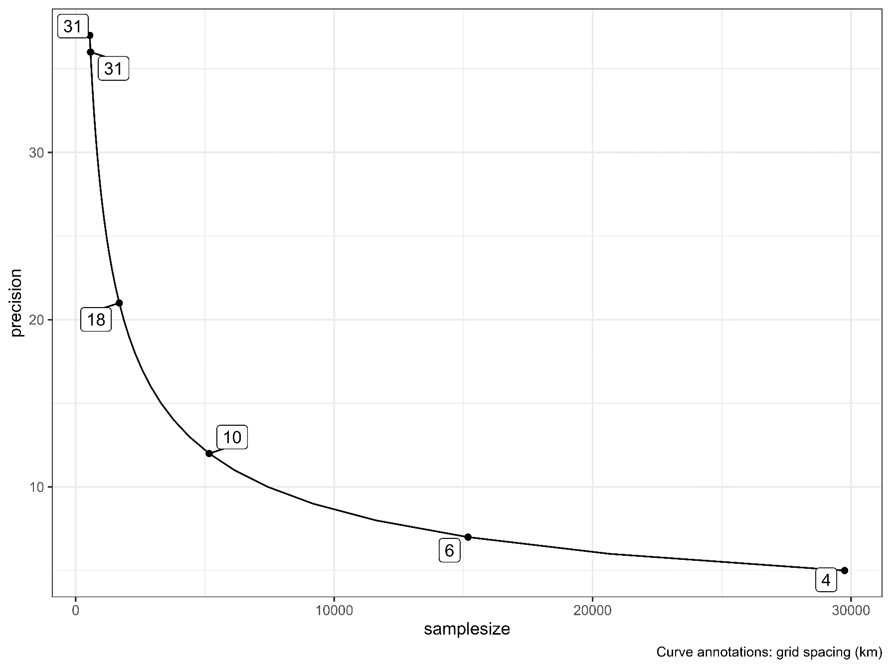
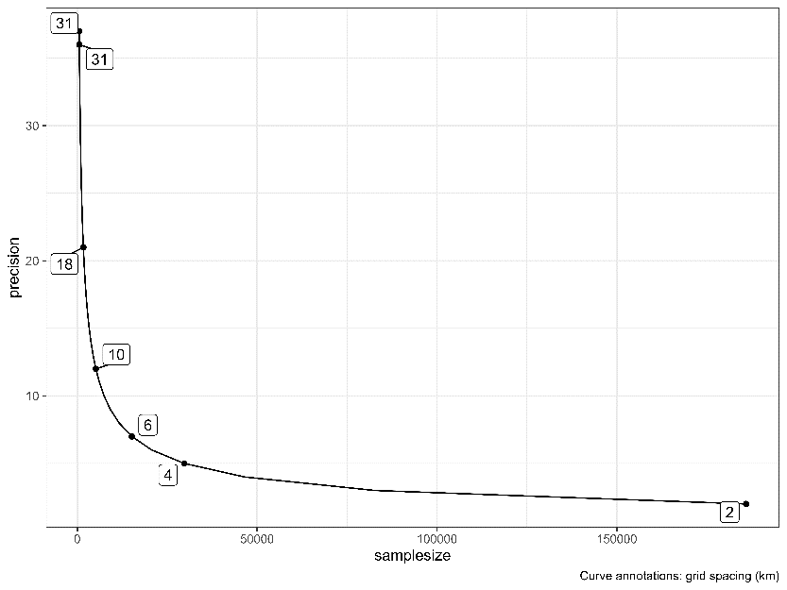
Phase 1 sampling size and grid spacing
Example: Kalimantan
Alternative DF based

Slide 13
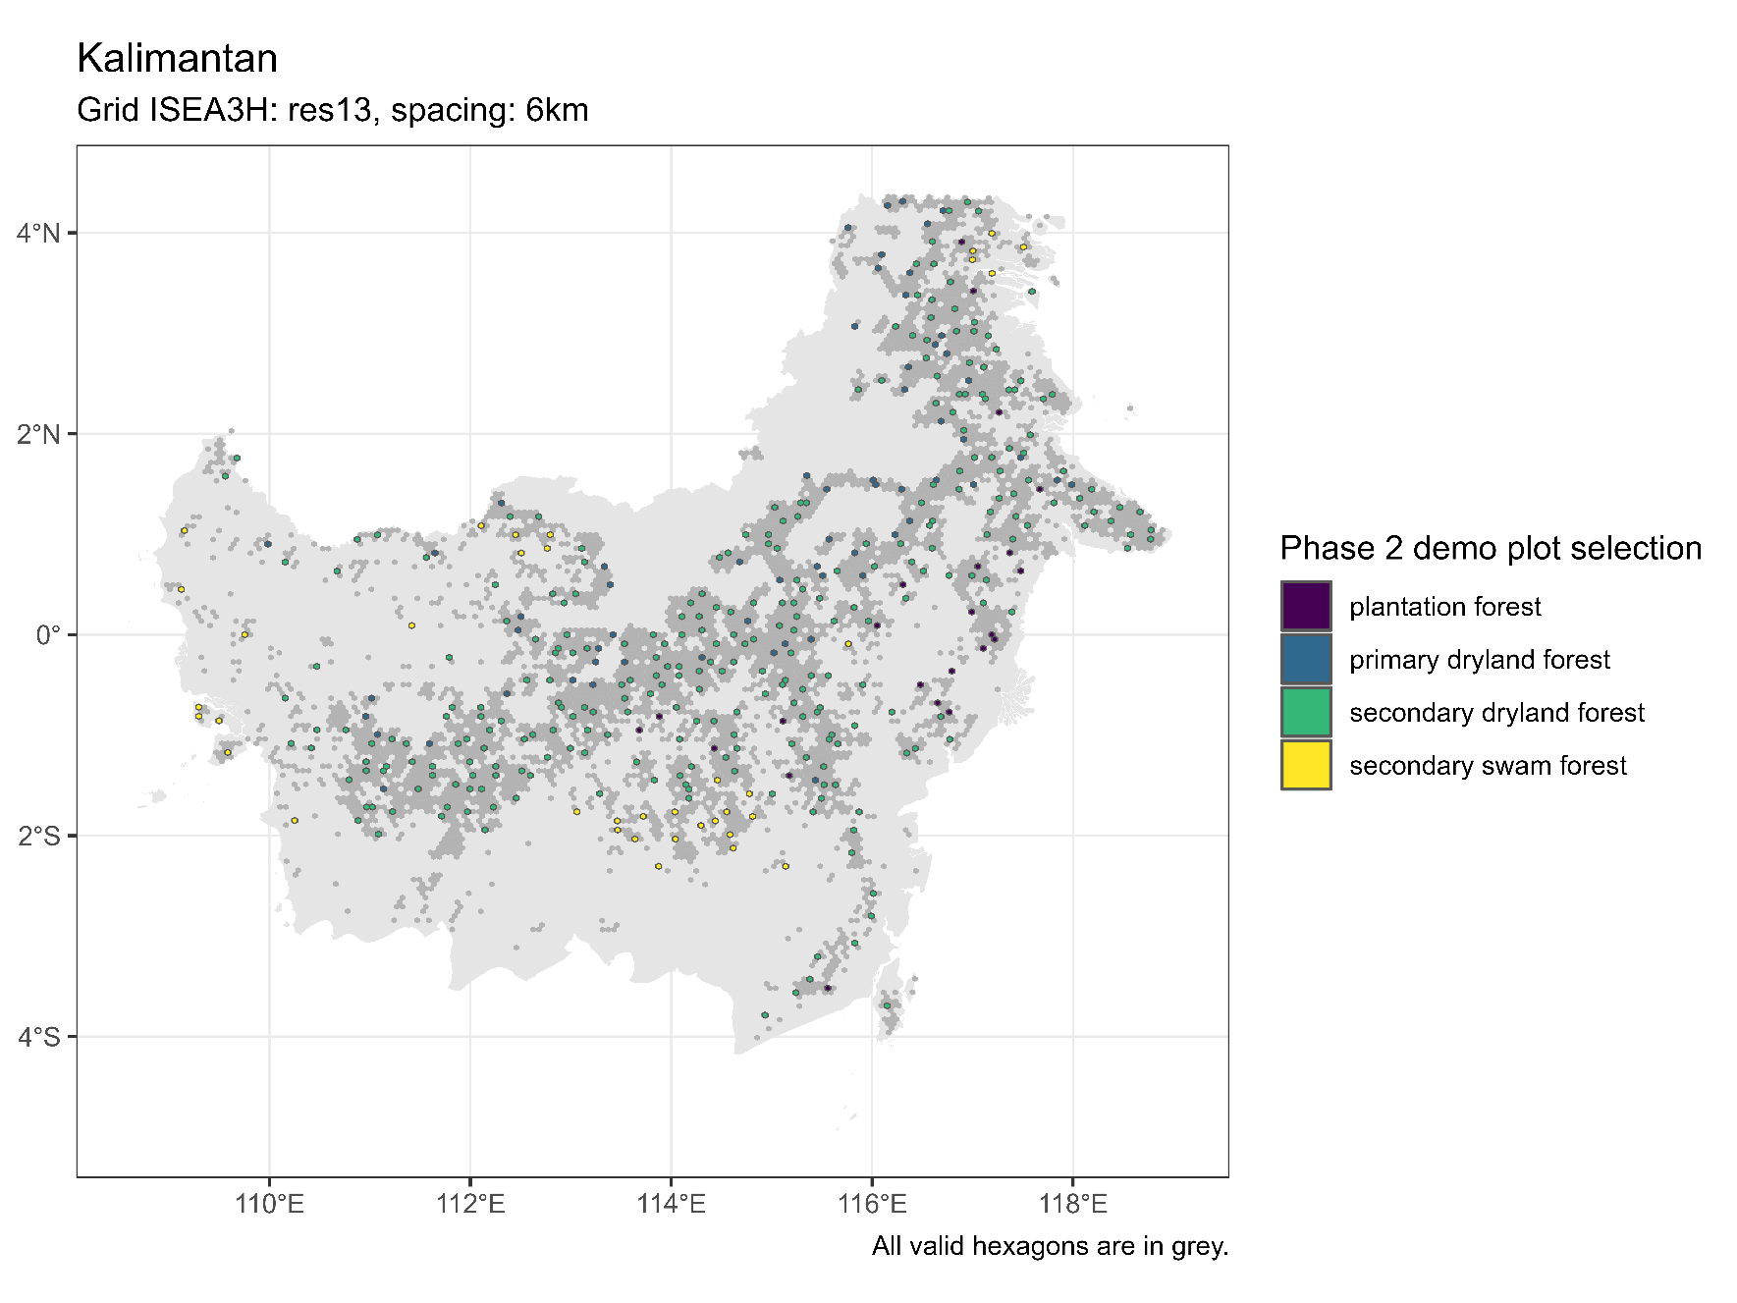
Phase 1 sampling size and grid spacing
Example: Kalimantan
Alternative 6 km grid
lc2021_group | total | no_access | access | valid
natural forest | 16820 | 3781 | 4568 | 4469
other land | 16820 | 585 | 2736 | 0
plantation forest | 16820 | 50 | 302 | 302
tree outside forest | 16820 | 1040 | 3758 | 0
TOTAL | 67280 | 5456 | 11364 | 4771

Slide 14
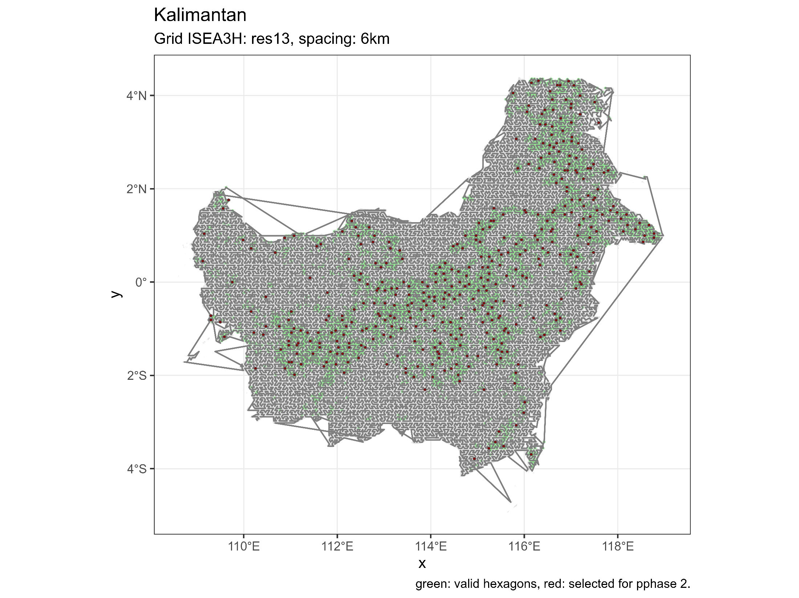
Phase 1 sampling size and grid spacing
Example: Kalimantan
Alternative 6 km grid

Slide 15
Overall process
REMAINING QUESTIONS:
Proportion of permanent and temporary samples?
if not all permanent, SFC for permanent only?
In SFC article and Ethiopia, the SFC initial pol is very large compared to the sample size (11,064,467/139 or 320000/5000). Should we drastically increase phase 1? => Check deforestation based sampling size.

Slide 16
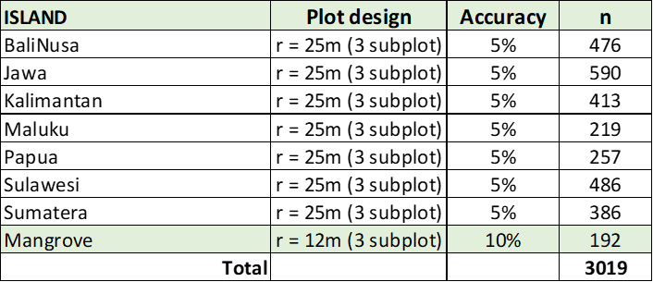
Phase 2 plot selection process (space filling curve)
Prerequisites:
Known phase 2 sampling size (n_plot)
Known phase 1 valid plots to select from (n_valid)
Process: achieve a quasi-uniform distribution of n_plot among the n_valid potential candidates.
Cluster size for spatially balanced n_plot, we create n_cluster = n_plot with the following cluster size and sampling proportion:
cluster_size = round(n_valid/n_plot)
sampling_proportion= 1 / cluster_size
Random starting point 'start_point' within the first cluster, i.e the range of [1:cluster_size]
For each point 'i' in the range [start_point:n_valid]
if i-th position from start_point match the cluster size limit record the id of the i-th valid point
formula: ceiling((i - starting_point + 1)* sampling_proportion) == j) with j initial value is 1 and then j <- j + 1 when condition met.
j keeps track of what plot rank is being selected

Slide 17
Phase 2 plot selection process (space filling curve)
Example:
n_valid = 20 ; n_plot = 5 => cluster_size = 20/5 = 4, sampling_proportion = 1 / 4 = 0.25
start_point is random in [1:4] => start_point = 3
initial start of for loop: j = 1, i = 3
i = 3 --- ceiling((3 - 3 + 1) * 0.25) = 1 ; j = 1 --- VALID: valid point 3 is selected, j = 2
i = 4 --- ceiling((4 - 3 + 1) * 0.25) = 1 ; j = 2 --- SKIP
i = 5 --- ceiling((5 - 3 + 1) * 0.25) = 1 ; j = 2 --- SKIP
i = 6 --- ceiling((6 - 3 + 1) * 0.25) = 1 ; j = 2 --- SKIP
i = 7 --- ceiling((7 - 3 + 1) * 0.25) = 2 ; j = 2 --- VALID: valid point 7 is selected, j = 3
i = 8 --- ceiling((8 - 3 + 1) * 0.25) = 2 ; j = 3 --- SKIP
i = 9 --- ceiling((9 - 3 + 1) * 0.25) = 2 ; j = 3 --- SKIP
i = 10 --- ceiling((10 - 3 + 1) * 0.25) = 2 ; j = 3 --- SKIP
i = 11 --- ceiling((11 - 3 + 1) * 0.25) = 3 ; j = 3 --- VALID
…
1
2
3
4
5
6
7
8
9
10
11
12
13
14
15
16
17
18
19
20
3
7
11
15
19

